Slide 1

Seaborn
And Other High-Level Plotting Tool Kits

Slide 2
Matplotlib: Today
pylab interface
matplotlib API
backends
Notes:
other names for the same things
top level is what you get with pylab (scipy), pandas

Slide 3
Another Level
seaborn ggplot basemap holoviews prettyplotlib mplot3d AxesGrid
pylab interface
matplotlib API
backends
Notes:
other names for the same things
top level is what you get with pylab (scipy), pandas

Slide 4
List maintained at http://matplotlib.org/mpl_toolkits/

Slide 5
Basemap, Cartopy
Notes:
More on these when we talk about geographic visualization

Slide 6
mplot3d
Notes:
basic 3d (see VTK for more)

Slide 7
AxesGrid
Notes:
mplcursors, GTK Tools, mpld3, excel tools

Slide 8
mpld3
Connects matplotlib to a D3 as a backend
Notes:
from the high level, uses a different backend. a bit strange, should be implemented as a backend!
%matplotlib d3

Slide 9
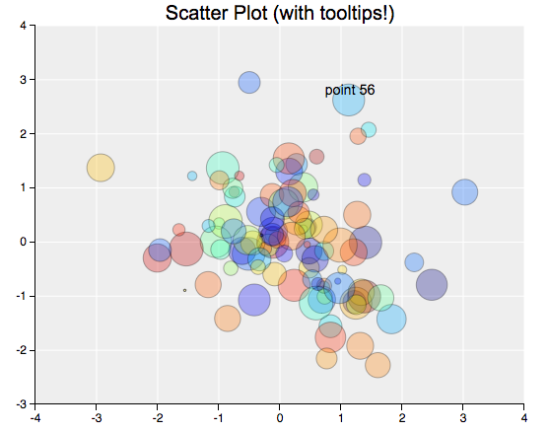
mpld3
Connects matplotlib to a D3 as a backend
Notes:
this seems like the best use-case (exploratory graphics)

Slide 10
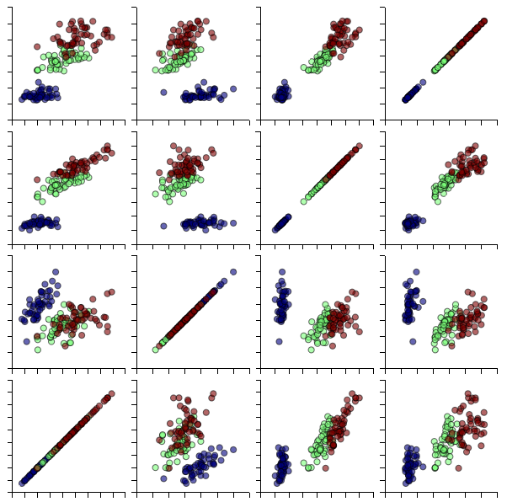
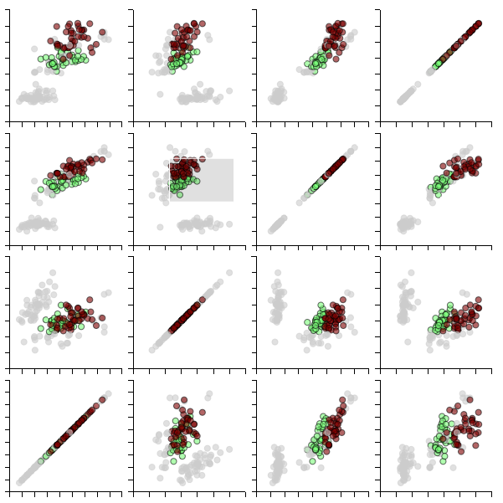
mpld3

Slide 11
mpld3
http://mpld3.github.io/

Slide 12
seaborn!
Notes:
http://seaborn.pydata.org/examples/index.html#example-gallery

Slide 13
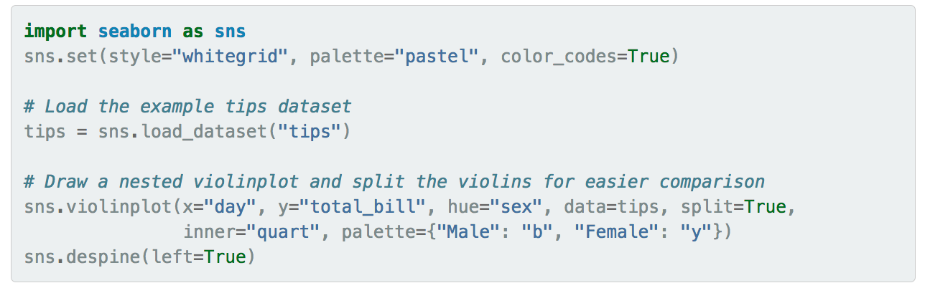
seaborn!
Notes:
http://seaborn.pydata.org/examples/index.html#example-gallery

Slide 14
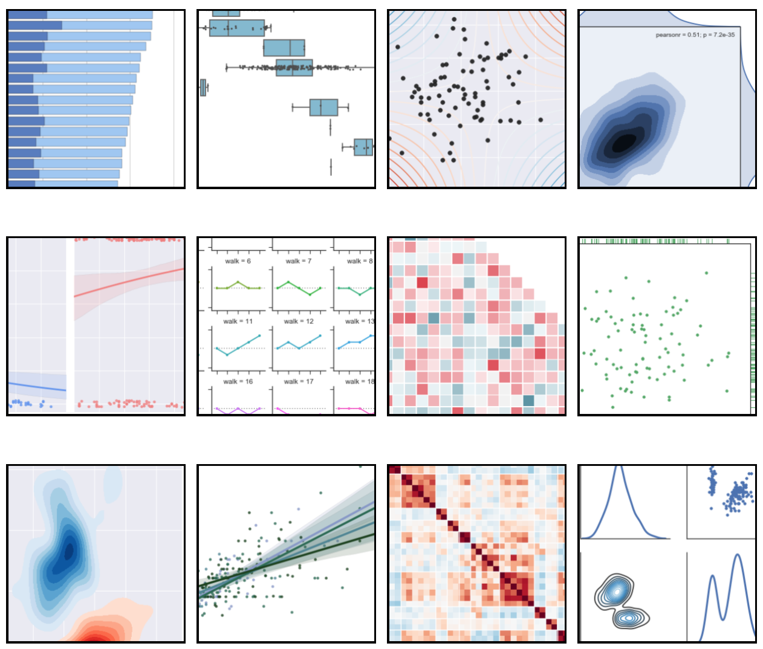
seaborn!
Notes:
and more!

Slide 15
seaborn!
http://seaborn.pydata.org/examples/
Notes:
and more!

Slide 16
Other Notables
Use Jupyter widgets + Matplotlib to generate interactive graphics.

Slide 17
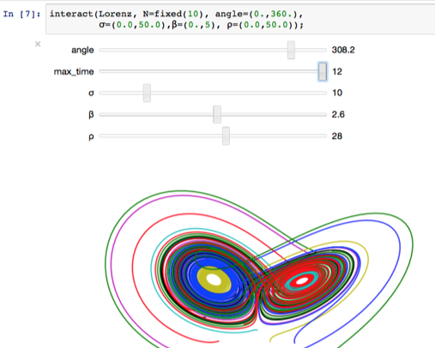
Other Notables
Notes:
http://blog.ibmjstart.net/2016/03/21/powered-by-jupyter/

Slide 18
Other Notables
Notes:
http://ipywidgets.readthedocs.io/en/latest/examples/Widget%20Basics.html

Slide 19
Other Notable Matplotlib Strategies
Use Jupyter widgets + Matplotlib to generate interactive graphics.
Define your own plotting function in Matplotlib (e.g., Pandas does this).

Slide 20
Other Notable Matplotlib Strategies
Use Jupyter widgets + Matplotlib to generate interactive graphics.
Define your own plotting function in Matplotlib (e.g., Pandas does this).
Transfer data to custom D3 visualization inside Jupyter.

Slide 21


